Slide 1
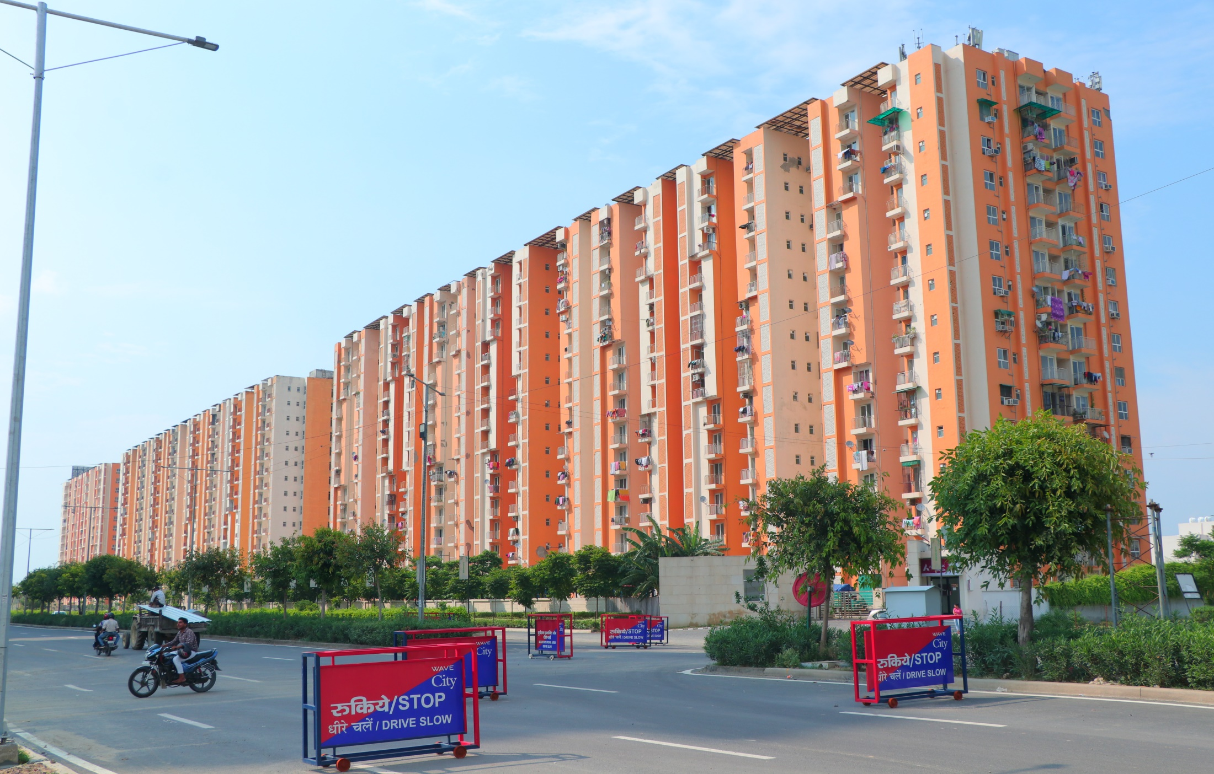
Dream Homes - 1,2,3 BHK Prise Start From 18Lakhs
Choudhary & Jha Associates – www.Jhaassociate.in

Slide 2
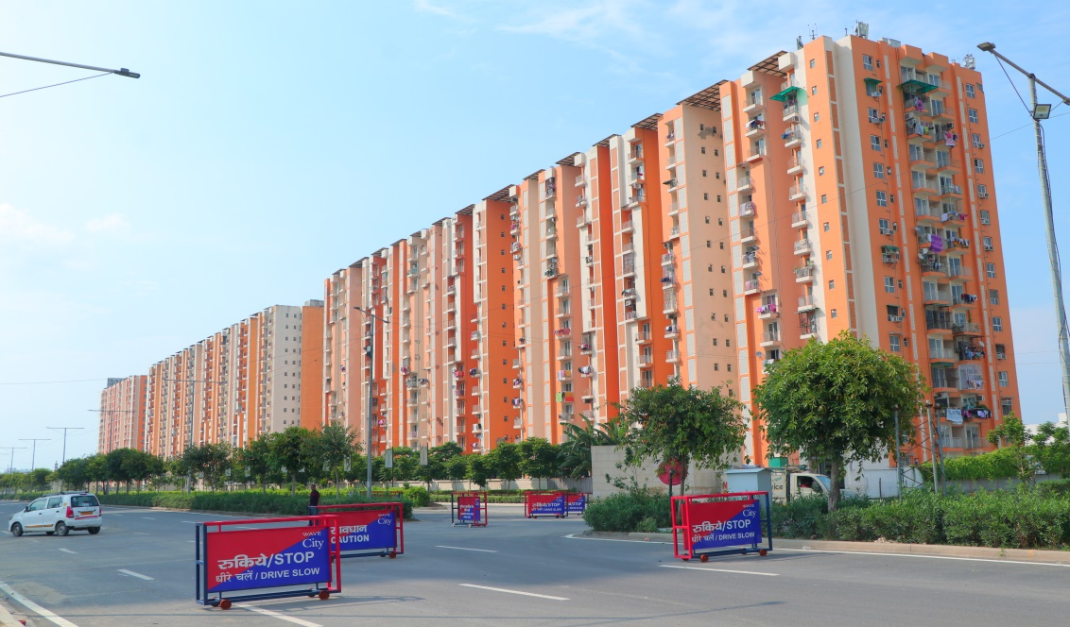
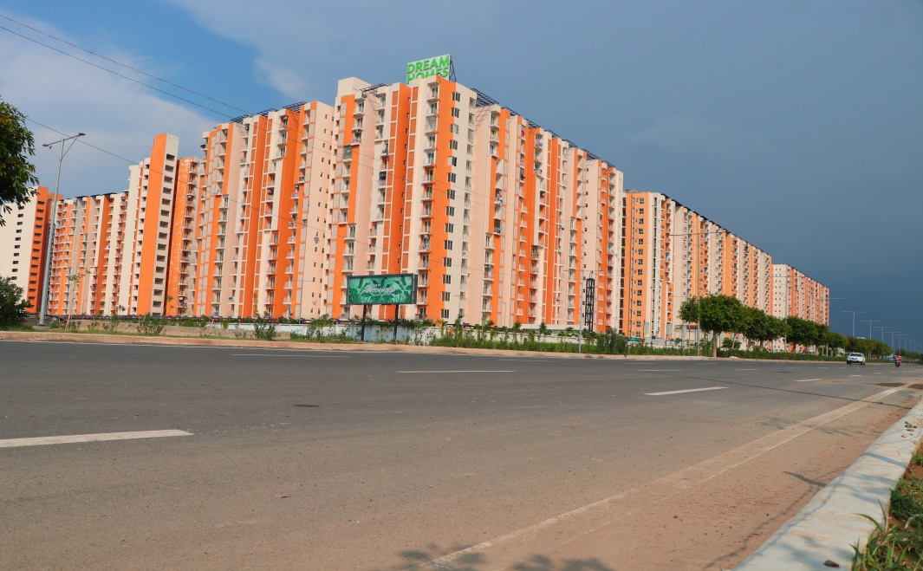
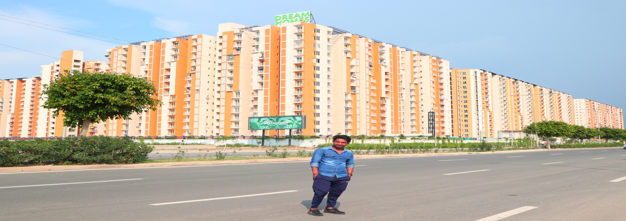
Choudhary & Jha Associates – www.Jhaassociate.in
Wave City – Dream Homes – 1,2,3 Bhk *Price Start from 18 Lakhs

Slide 3
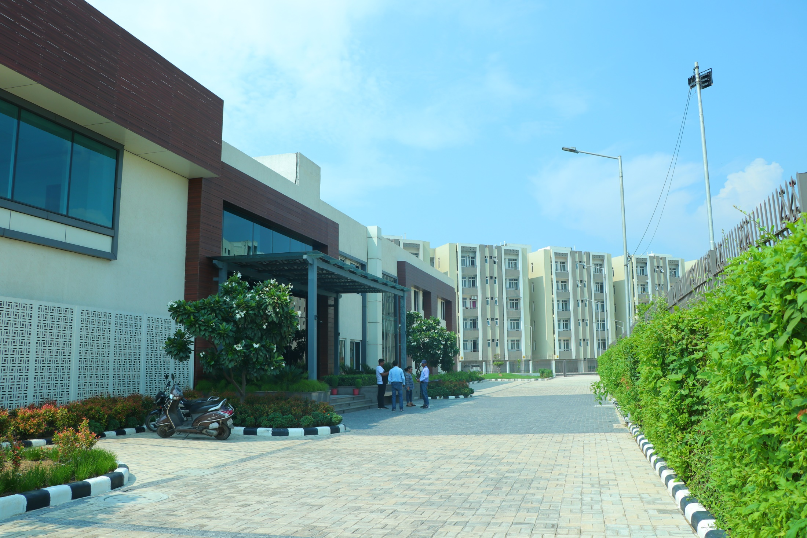
Executive Floor – Club House
Club House
Choudhary & Jha Associates – www.Jhaassociate.in

Slide 4
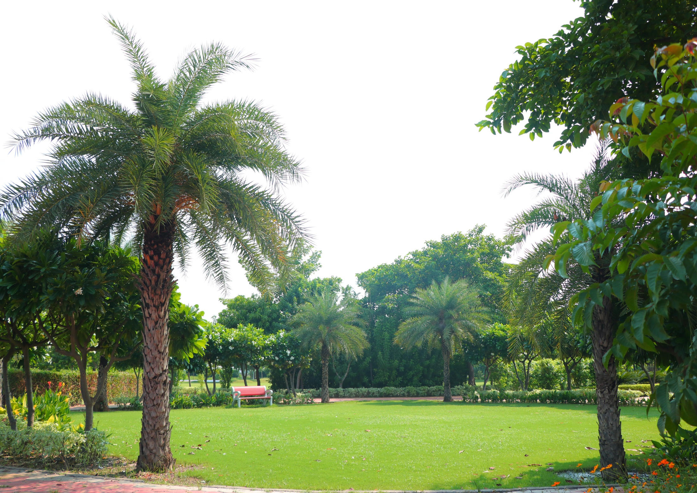
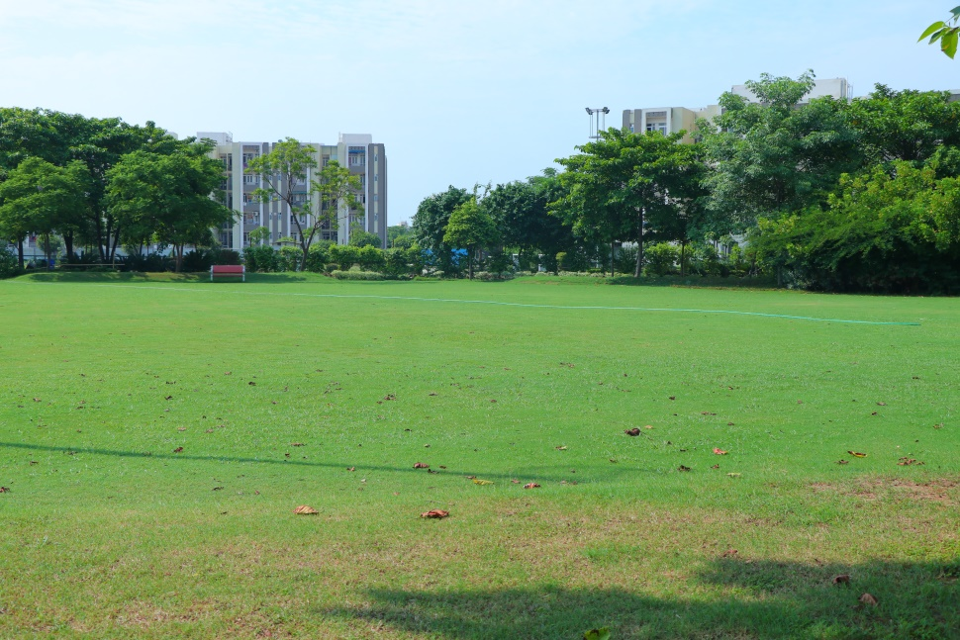
Central Park

Slide 5
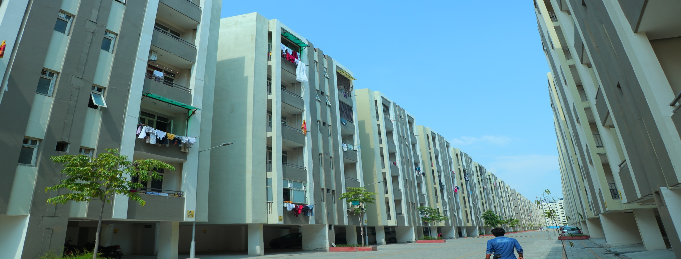
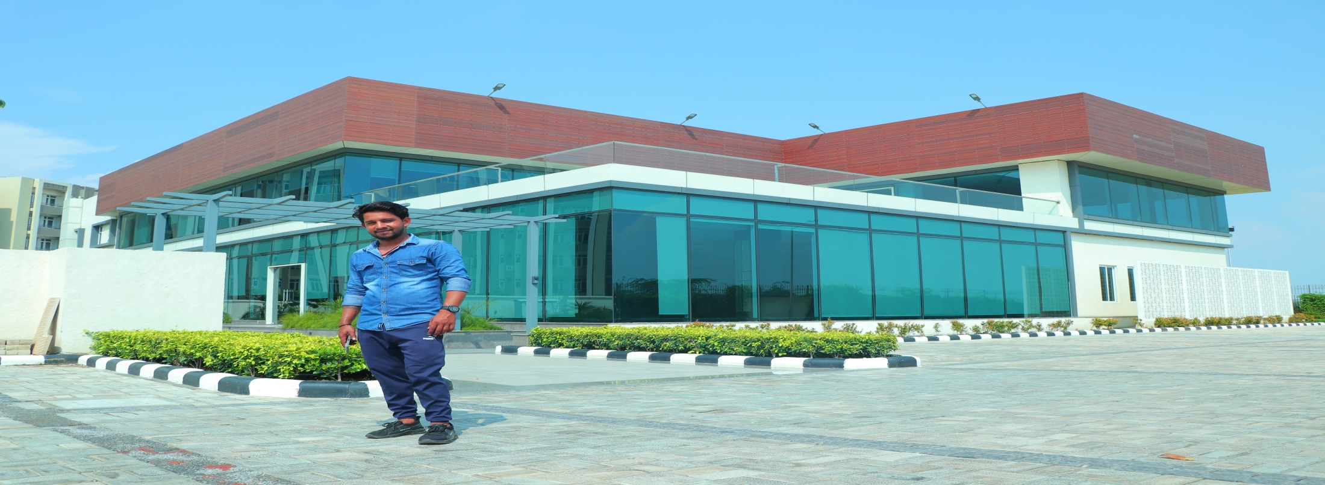
Choudhary & Jha Associates – Ghaziabad – www.jhaassociate.in

Slide 6
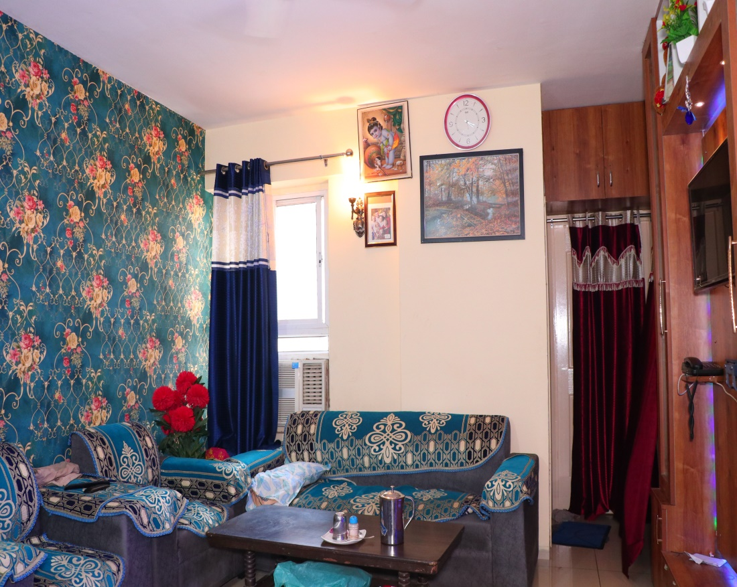
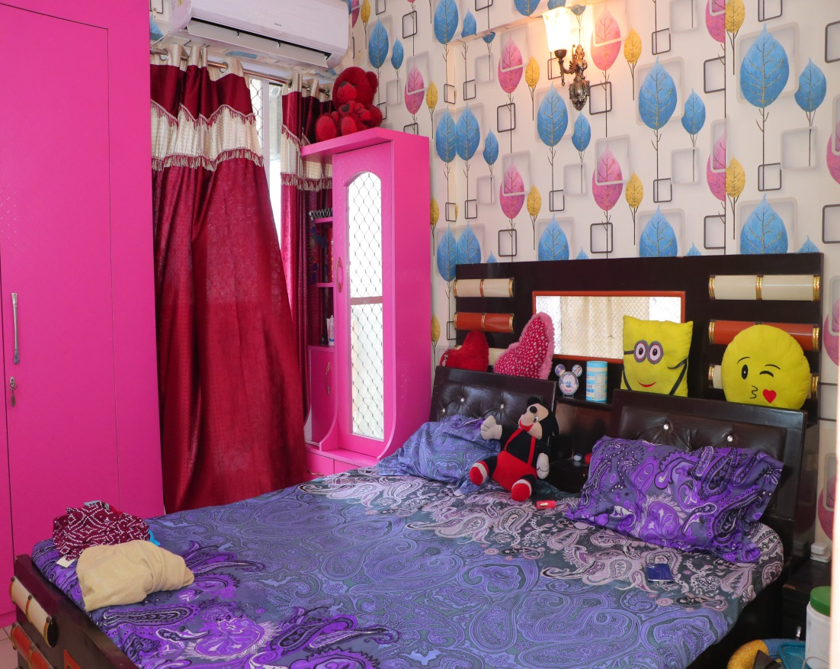
Choudhary & Jha Associates – www.Jhaassociate.in

Slide 7
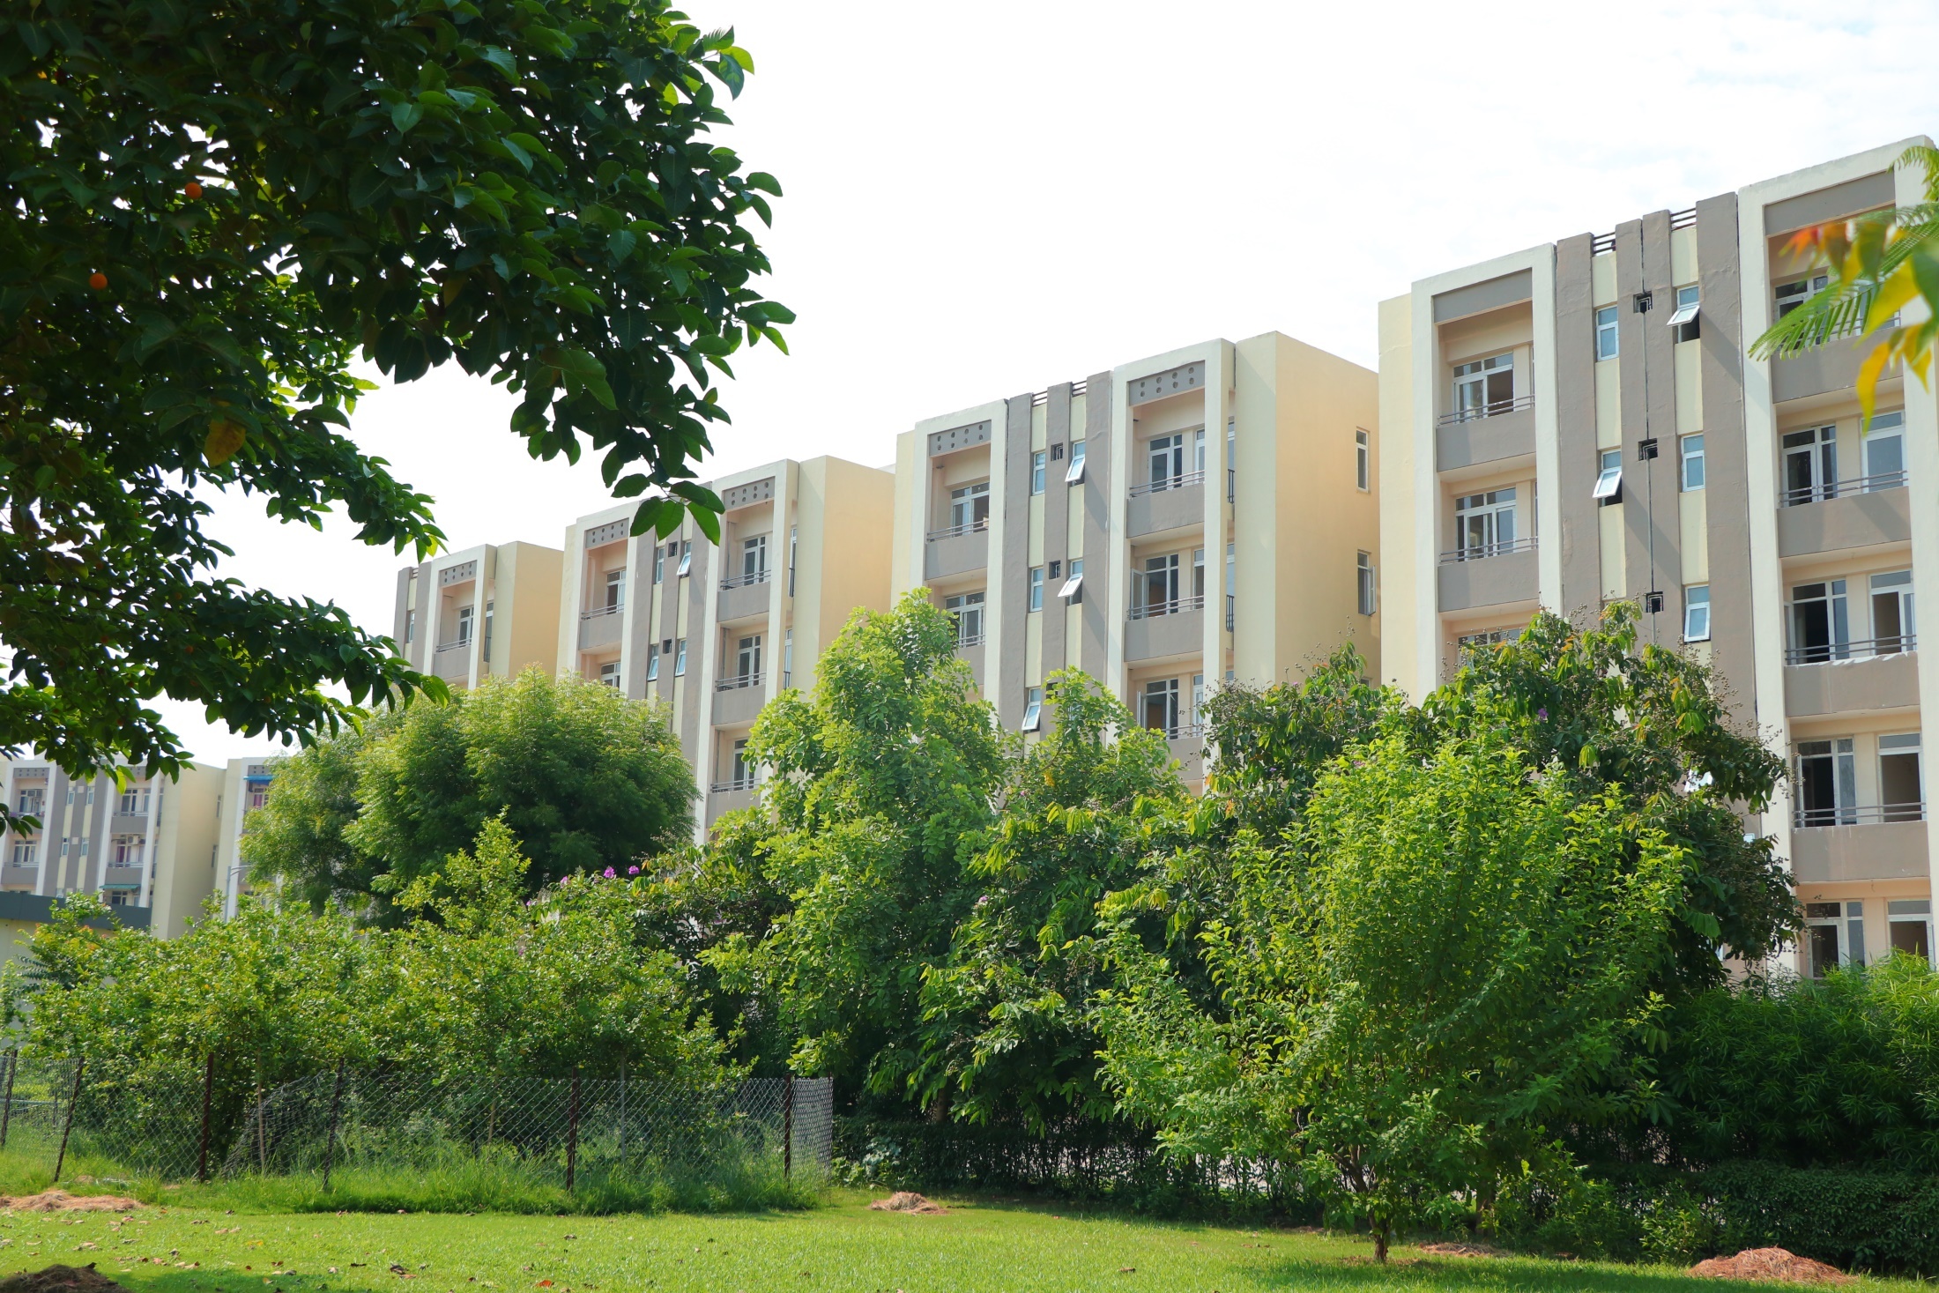
Wave Executive Floors – 2& 3 Bhk Price Start From – 37Lakhs
Choudhary & Jha Associates – www.Jhaassociate.in

